Slide 1
Department of MCA
A Cloud-Deployed Intelligent Web Platform for Automated Resume Creation and Optimization Using MERN Stack
Under the Guidance of Dr N.Venkata ramana
By :
Bommineni soumya
2401600010
Dept. of MCA. KL University.

Slide 2
Introduction
Problem Statement:
Many users find it difficult to create professional resumes due to lack of formatting knowledge and proper tools.
To simplify resume creation using a structured, user-friendly web application with secure data management.

Slide 3
Objectives
To develop a AI web-based resume builder
To reduce manual effort in resume creation
To provide structured resume generation
To ensure secure user authentication
To enable easy preview and download

Slide 4
Literature Survey
Existing tools like Canva, Zety provide templates
Most platforms have paid features
Limited customization and data control
Lack of full-stack integration
Need for secure and flexible system

Slide 5
Methodology
Approach Used:
MERN Stack (React, Node.js, MongoDB)
Client-Server Architecture
Flow: Register → Login → Create Resume → Preview → Download

Slide 6
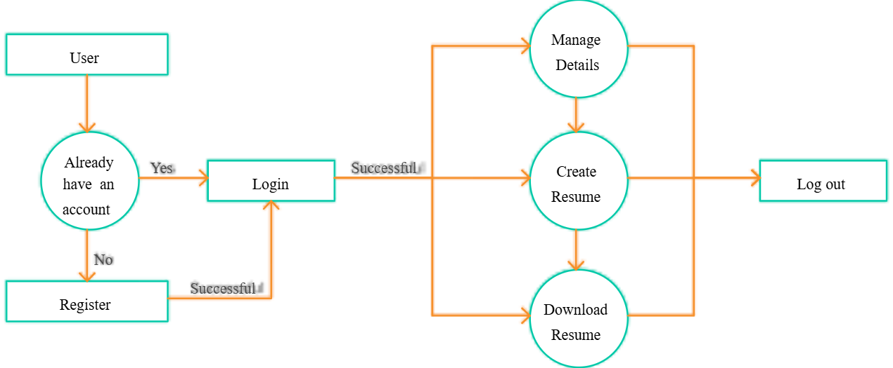
System workflow

Slide 7
Technologies Used
React.js (Frontend)
Tailwind CSS (UI Design)
Redux Toolkit (State Management)
Node.js & Express.js (Backend)
MongoDB (Database)
JWT & bcrypt (Security)
Vercel (Deployment)

Slide 8
Implementation
Modules:
The Authentication Module manages user registration and login, ensuring that only authorized users can access the system securely.
The Resume Creation Module allows users to enter their personal and professional details in a structured format and build their resume easily.
The Resume Upload Module provides flexibility by allowing users to upload their existing resumes into the system for storage and management.
Finally, the Preview & Download Module enables users to view their complete resume in a professional format and download it as a PDF.

Slide 9
Results & Output
User registration and login working
Resume creation and storage successful
Resume preview working properly
Resume download as PDF
Smooth frontend-backend integration
Google gemini api integration

Slide 10
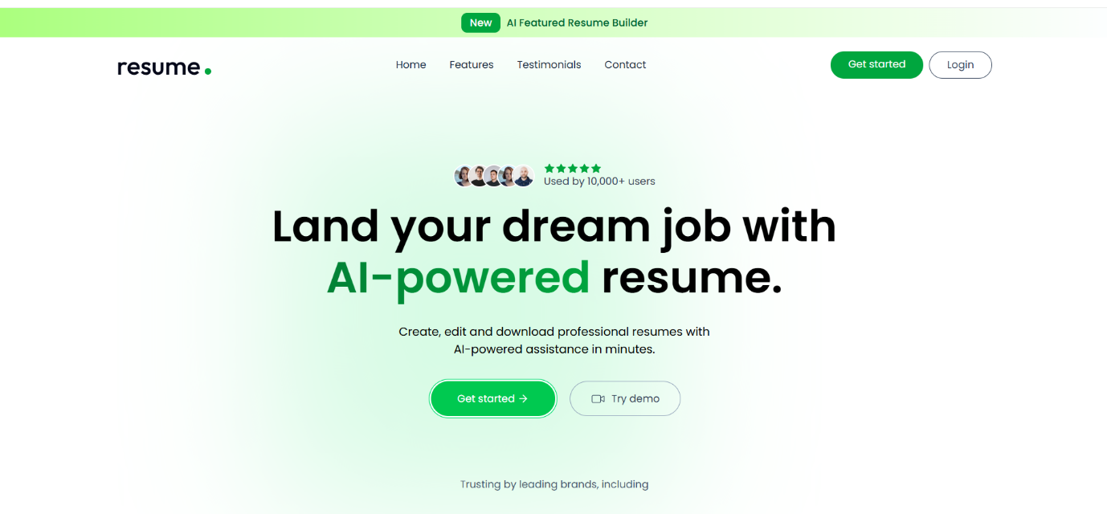

Slide 11
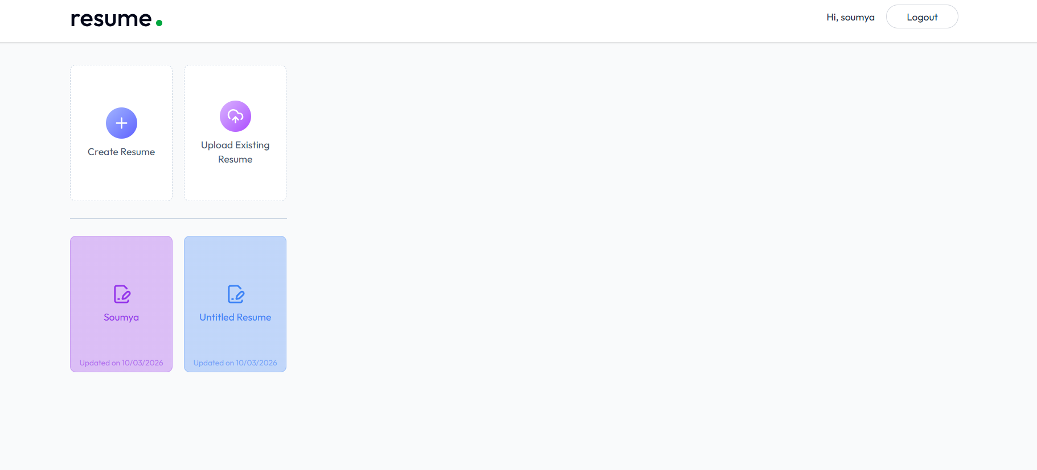

Slide 12
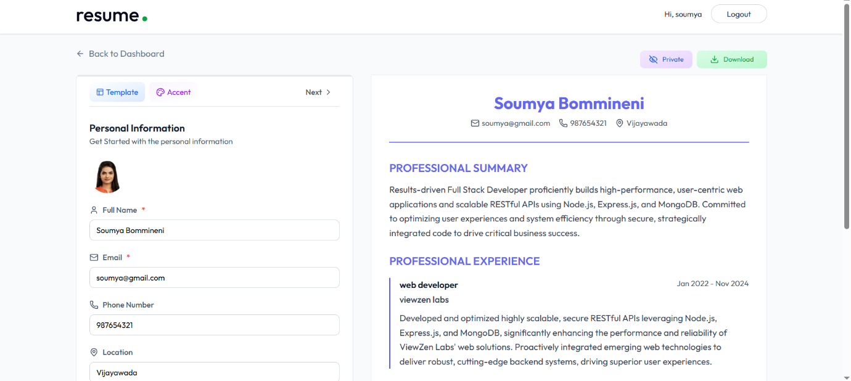

Slide 13
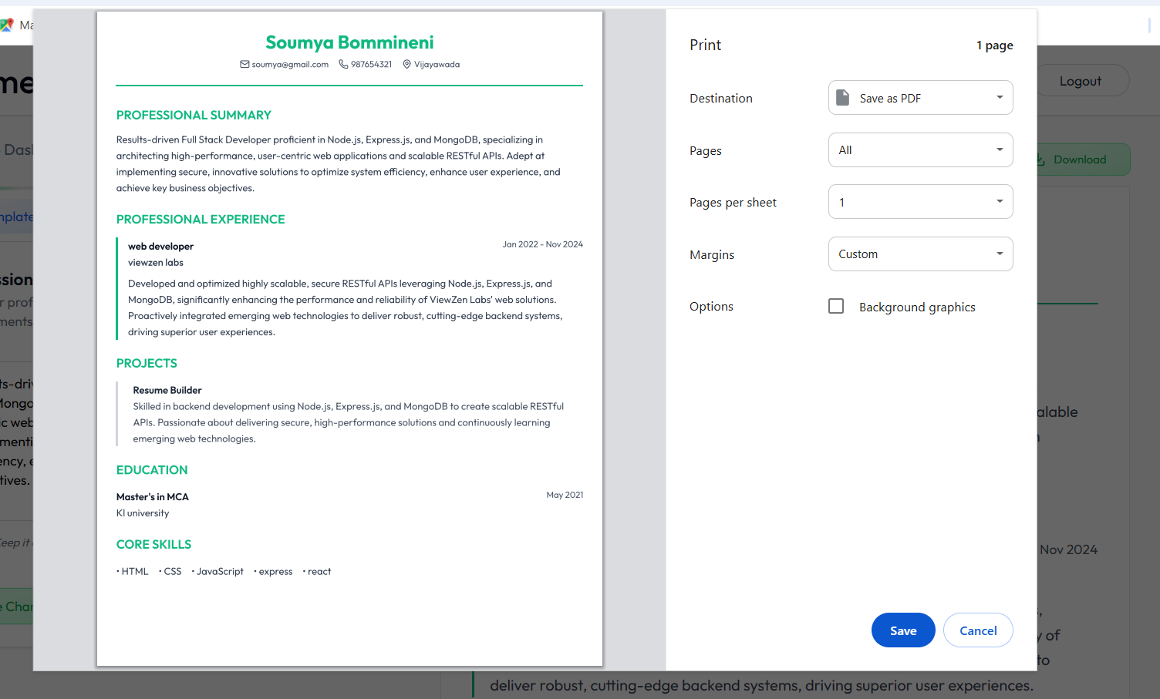

Slide 14
Advantages
Easy to use interface
Secure authentication
Saves time and effort
Cloud-based access
Structured resume format

Slide 15
Limitations
Limited number of resume templates available
Requires internet connection to access the application
Limited customization compared to advanced professional tools

Slide 16
Future Scope
AI-based resume enhancement
Mobile application development
More templates and customization
Integration with job portals

Slide 17
Conclusion
The project provides an intelligent efficient solution for resume creation using modern web technologies.
It ensures secure data handling, user-friendly design, and cloud accessibility
The system successfully meets its objectives and can be enhanced further in future.

Slide 18
Thank you…!

